Slide 1
IETF Hackathon
IETF 113
19 – 20 March 2022
Vienna

Slide 2
Note Well
This is a reminder of IETF policies in effect on various topics such as patents or code of conduct. It is only meant to point you in the right direction. Exceptions may apply. The IETF's patent policy and the definition of an IETF "contribution" and "participation" are set forth in BCP 79; please read it carefully.
As a reminder:
By participating in the IETF, you agree to follow IETF processes and policies.
If you are aware that any IETF contribution is covered by patents or patent applications that are owned or controlled by you or your sponsor, you must disclose that fact, or not participate in the discussion.
As a participant in or attendee to any IETF activity you acknowledge that written, audio, video, and photographic records of meetings may be made public.
Personal information that you provide to IETF will be handled in accordance with the IETF Privacy Statement.
As a participant or attendee, you agree to work respectfully with other participants; please contact the ombudsteam (https://www.ietf.org/contact/ombudsteam/) if you have questions or concerns about this.
Definitive information is in the documents listed below and other IETF BCPs. For advice, please talk to WG chairs or ADs:
BCP 9 (Internet Standards Process)
BCP 25 (Working Group processes)
BCP 25 (Anti-Harassment Procedures)
BCP 54 (Code of Conduct)
BCP 78 (Copyright)
BCP 79 (Patents, Participation)
https://www.ietf.org/privacy-policy/ (Privacy Policy)

Slide 3
Agenda - Sunday
09:30: Room opens - Pastries and coffee provided
12:30: Lunch provided
13:30: Hacking stops, prepare brief presentation of project
14:00: Project Results Presentations, see ​schedule, ​Meetecho
16:00: Hackathon ends
17:00: Tear down complete

Slide 4
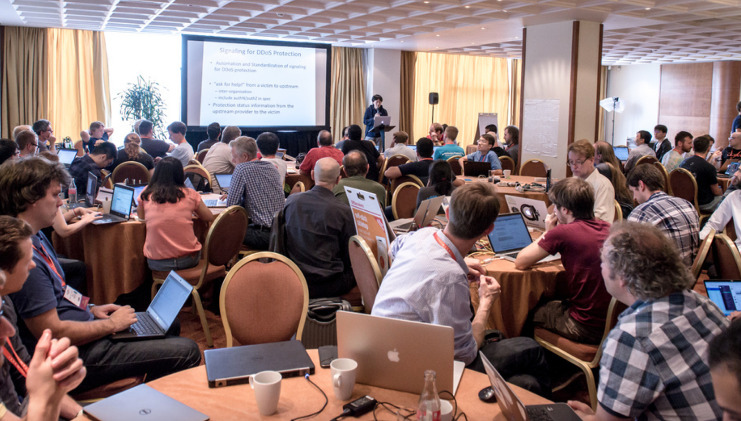
Results Presentations
What problem you tried to solve?
What you achieved?
Highlights
Lessons learned
Feedback to working group
Open source, other SDOs
5 minutes max

Slide 5
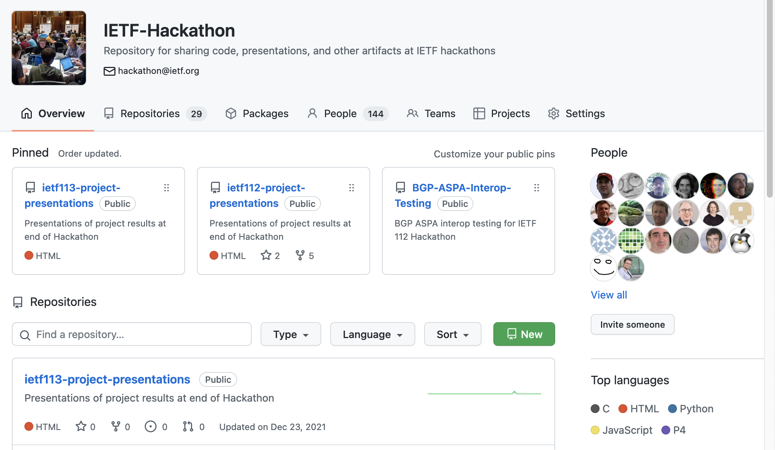
https://github.com/ietf-hackathon

Slide 6
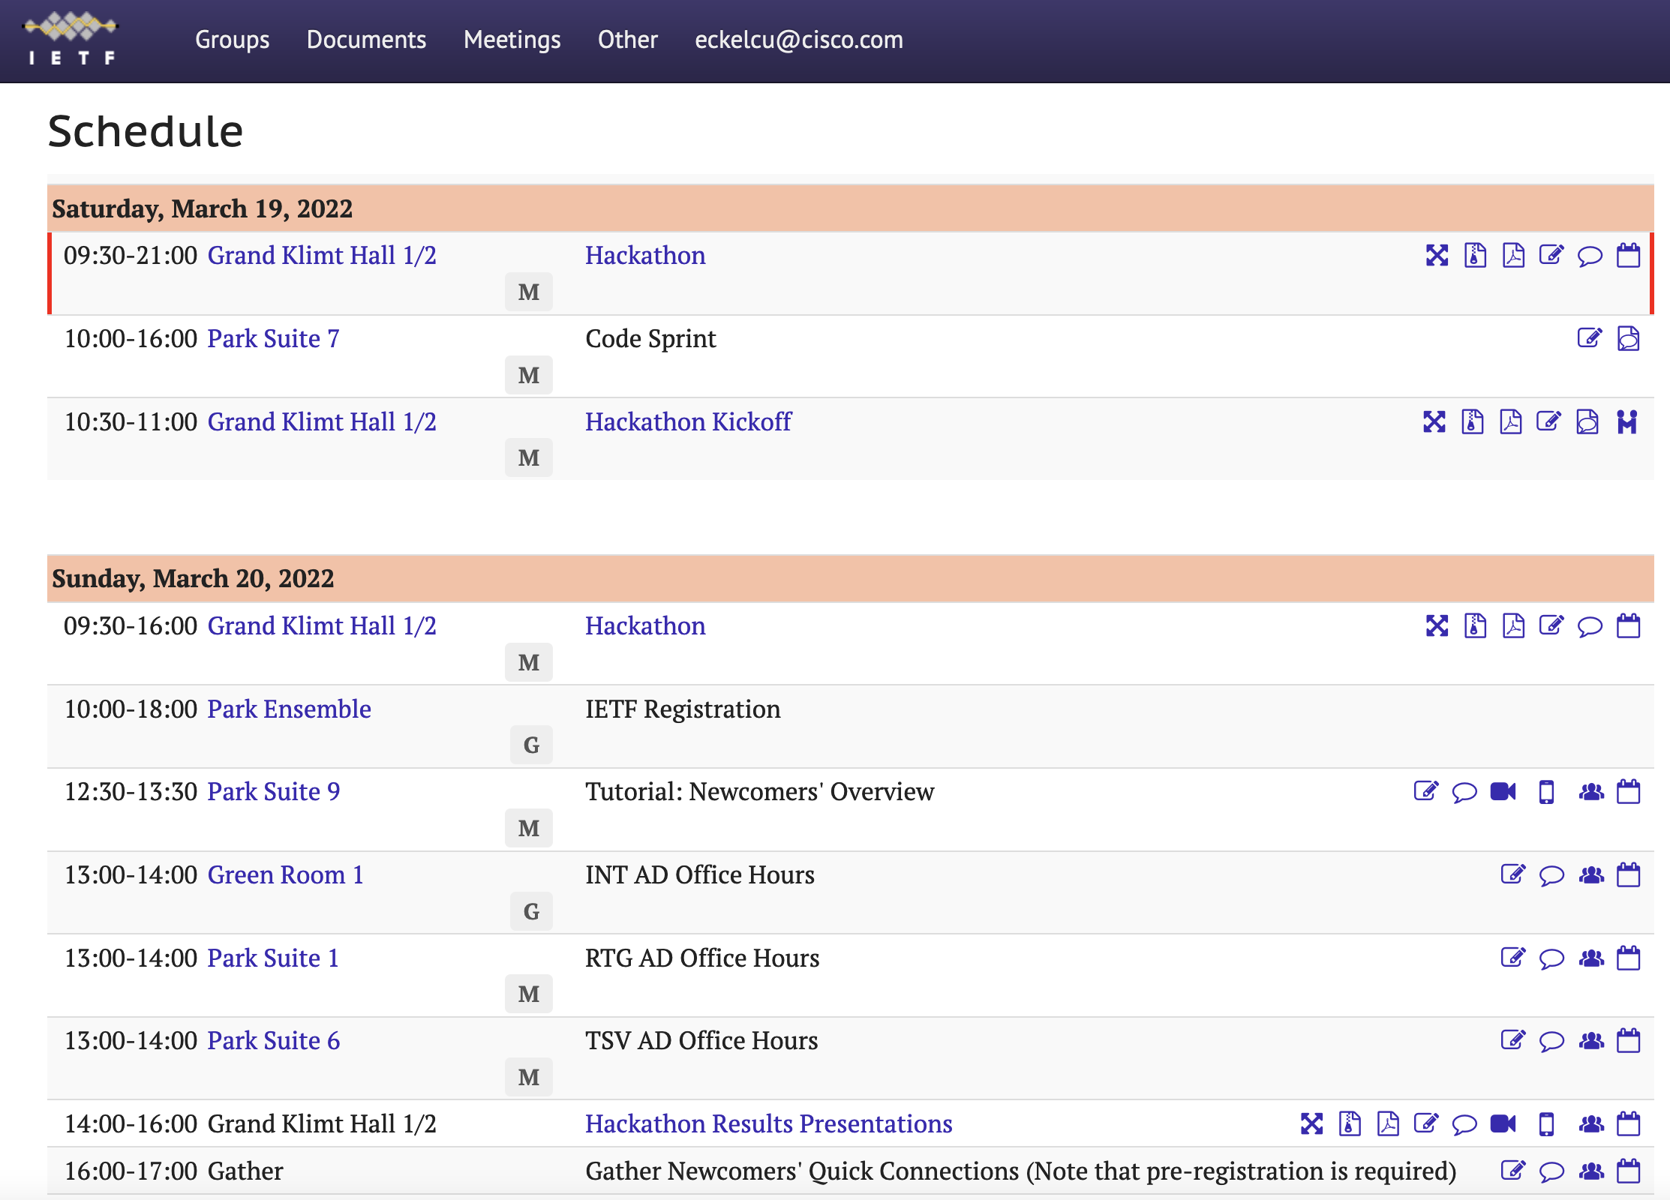
Meetecho
Click camera icon to access Meetecho session

Slide 7
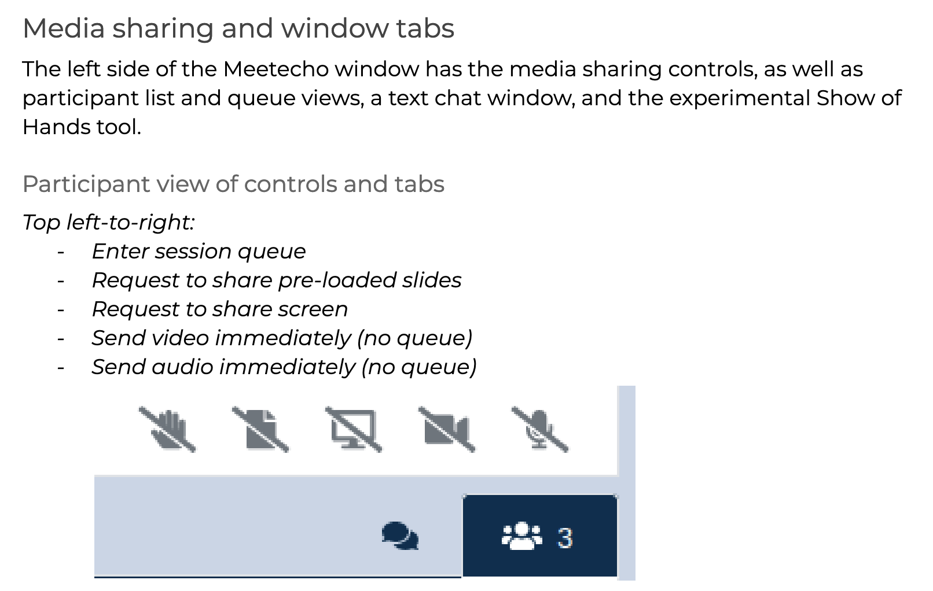
Sharing presentations

Slide 8
Sharing presentations

Slide 9
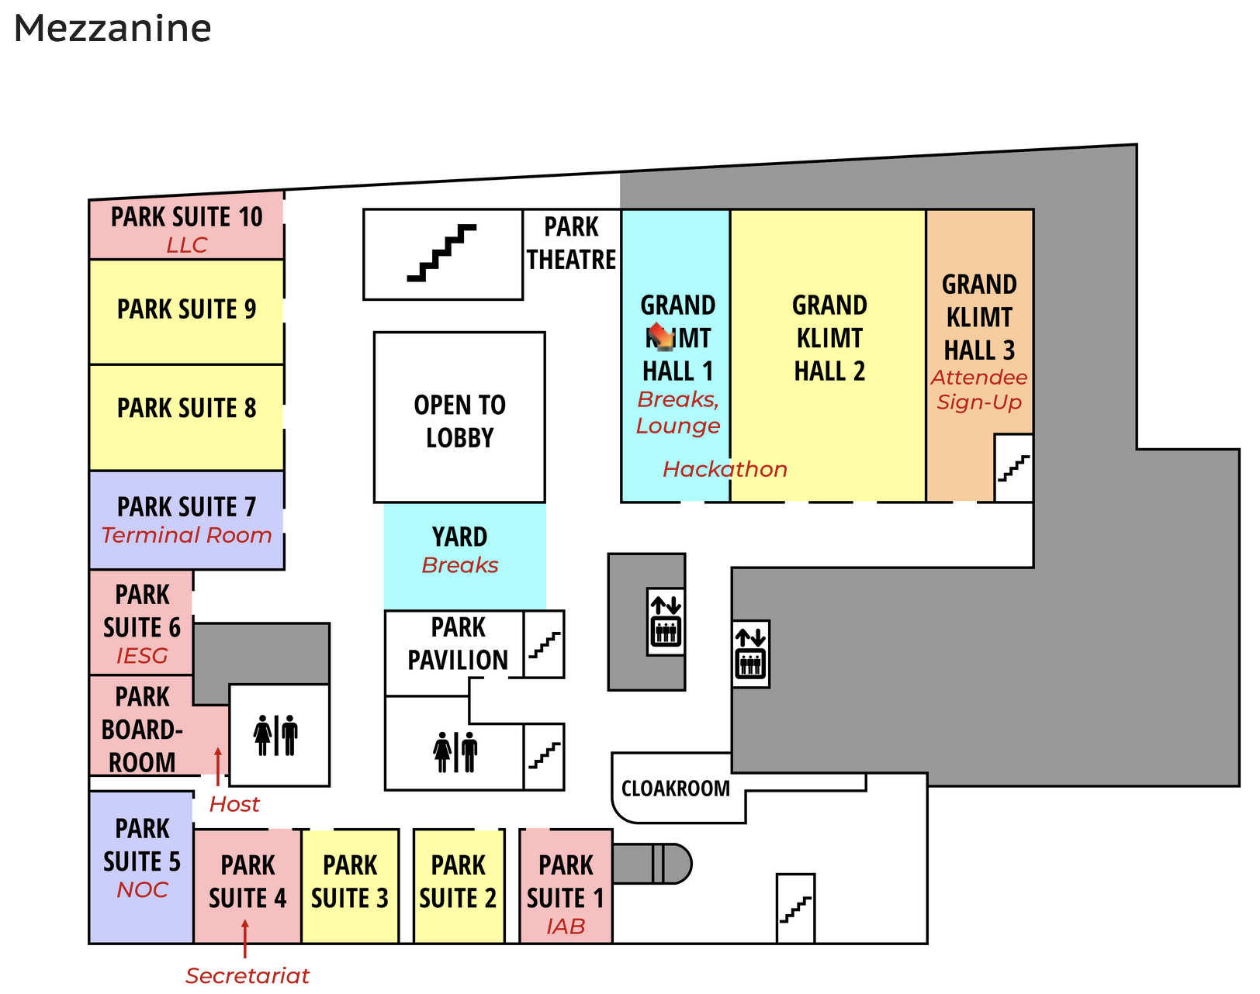
Hackdemo Happy Hour
Share hackathon projects with IETF Community
Grand Klimt Hall 1
Monday 17:00 - 18:30
Register your team
MUST REGISTER BY 12:00 MONDAY

Slide 10
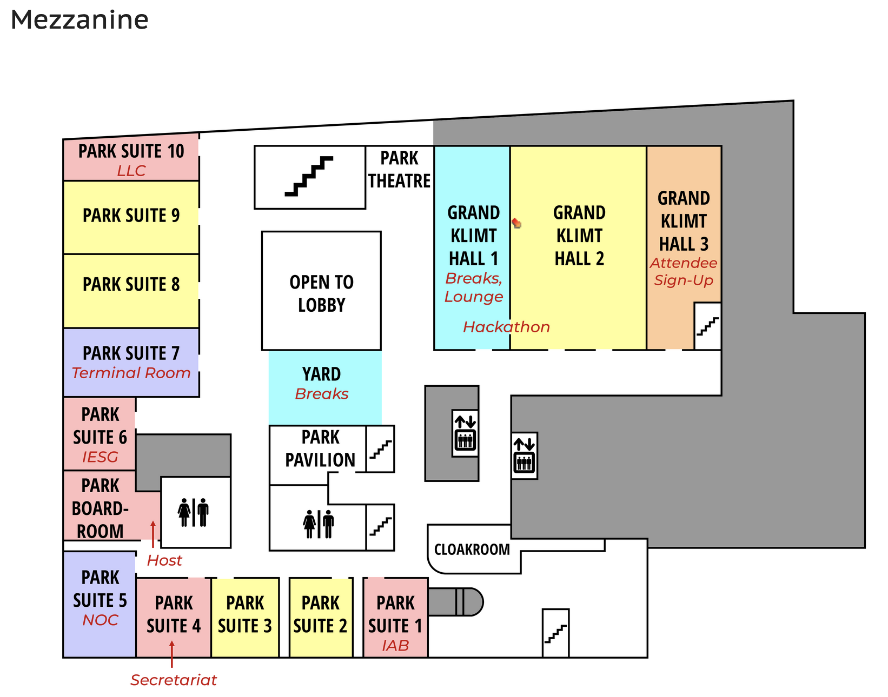
Code Lounge
Grand Klimt Hall 1/2
Space reserved in IETF lounge all week
Collaborate on running code
Schedule time for your team

Slide 11

THANK YOU!

Slide 12
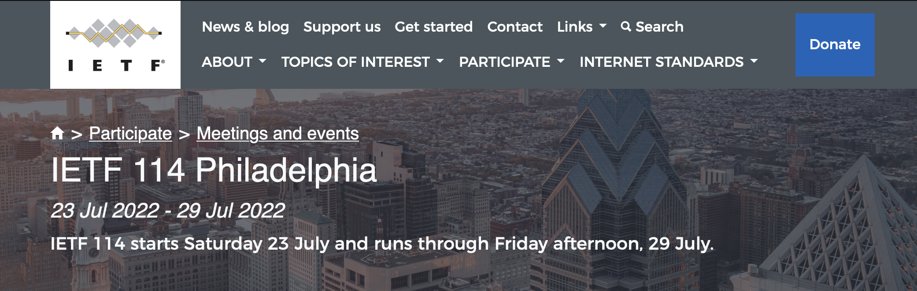
Hope to see you in Philadelphia!

